Slide 1
User Story Writing Workshop
4Q2015
Small & Fernstrom

Slide 2
Welcome!
Learning Objectives – Upon completing this class, you’ll be able to:
Create a Vision Statement
Create Story Maps
Write User Stories and Acceptance Criteria
Participate in Release Planning
Do Agile Estimation
Participate in Iteration Planning
Better understand the Agile Life Cycle
Apply the learning from the workshop in your day-to-day work

Slide 3
What’s Our Working Agreement?
A Working Agreement defines the specific rules or norms that the team chooses to adopt to assure their effectiveness
For example:
Be present, engaged
Participate
No multitasking
What else will make this training effective and efficient??
Notes:
Talking points:
The working agreement is a way to make the success of the class (or the project) a shared responsibility.
This is our “contract” for how we work together towards that end.
It is not the facilitator’s or instructor’s job to enforce the agreement – it is everyone’s responsibility.
Periodically, the working agreement should be reviewed and updated according to the team’s needs

Slide 4
Agenda – User Story Workshop
Day 1
Morning: 8:00 – 12:00
Why Create a Story Map?
Develop Initial Story Map
Share Initial Work
Continue Developing Story Map
Present Updated Story Maps
Lunch: 12:00 – 1:00 pm
Afternoon: 1:00 – 5:00 pm
Expand into User Stories
Share User Stories
Start Grooming the Backlog
Share Acceptance Criteria
Day 2
Morning : 8:00 – 12:00
Planning Poker & Story Slicing
Share Experiences
Drafting Story Maps for Your Project
Share Experiences
Wrap Up

Slide 5
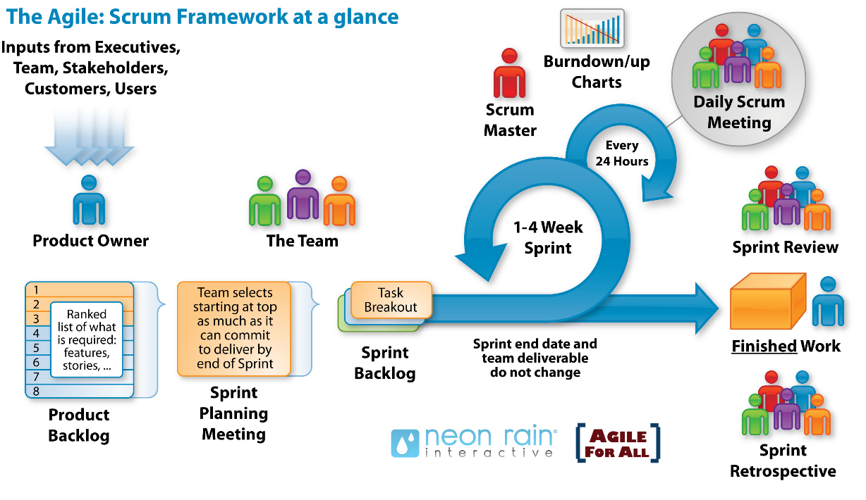

The Agile Life Cycle & Advanced Practices
Daily Touch Point
Chartering
Agile Team Facilitator (ATF)
Story Mapping
Release Planning
2 week Iteration
Value Team Facilitator (VTF)
Iteration Review
Iteration Backlog
Iteration end date and team deliverable do not change
Iteration Planning Meeting
Grooming Backlog

Slide 6
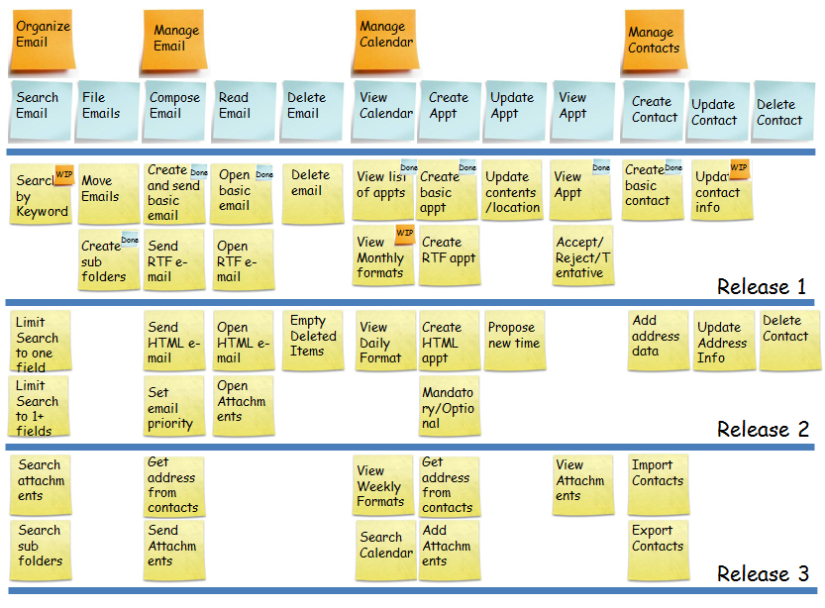



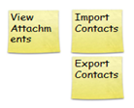

The Story Map
Epic
Features
Stories
Verb / noun pairs
Notes:
At the funnel level what we care about is if dependencies have been defined and there is a plan to complete the dependencies so that features don’t get hung up. It is expensive to build partial features (Lean concept of WIP being inventory = waste) and get work hung up in the system. We need a clear plan for scope for the next release

Slide 7
Story Map + Releases = Release Roadmap
Epics
Features
Stories
Notes:
At the funnel level what we care about is if dependencies have been defined and there is a plan to complete the dependencies so that features don’t get hung up. It is expensive to build partial features (Lean concept of WIP being inventory = waste) and get work hung up in the system. We need a clear plan for scope for the next release

Slide 8
Scenarios for Workshop

Slide 9
Scenario 1: Major League Baseball – Ticket Reselling
For years there has been an unsanctioned secondary market for the resale of tickets to MLB games; MLB has tried to prevent this and then pretend that it doesn’t exist. MLB has finally decided to use this as a business opportunity and run this market, earning a service fee for each transaction.
The commissioner of Major League Baseball has hired your team to develop the web site to host this market where people who have tickets and people who want to buy tickets can sell/buy.
Develop a story map that describes the epics, features, and user stories for your concept; identify the MVP and propose a sequence of releases for rolling out additional functionality.

Slide 10
Scenario 2: Hallmark – Reinvented For the Digital Age
Before the web, Hallmark was the dominant player in the greeting card industry; over the past 20 years, their market and market share has been eroded by more nimble start-ups
Your team has been hired to propose new concepts for how Hallmark can create “sticky” on-line relationship with customers who might buy greeting cards and gifts
Develop a story map that describes the epics, features, and user stories for your concept; identify the MVP and propose a sequence of releases for rolling out additional functionality.

Slide 11
Scenario 3: The Digital Driver’s Office
As part of its plan for world domination, Apple has decided to enter the automobile market and re-imagine how an all-digital dashboard can revolutionize the driver’s experience. They are skeptical of Google’s concept for a self-driving car and want to create a new experience for the driver, not to eliminate her.
Your team has been assembled to lead the concept development. Tim Cook and Jonathan Ive have assembled a panel to hear your concepts and give feedback
Develop a story map that describes the epics, features, and user stories for your concept; identify the MVP and propose a sequence of releases for rolling out additional functionality.

Slide 12
Scenario 4: Safe & Sound
The Bill & Melinda Gates Foundation has announced a grant opportunity to be awarded to develop an app to help teens cope with personal and social problems, especially bullying. According to the American Academy of Child and Adolescent Psychiatry, suicide is the third-leading cause of death for young people.
For your proposal, develop a story map to describe the range of functionality for teens (and other who might feel like they have no one to reach out to) in distress to find resources and get help in coping with stress, abuse, grieving, and reporting school safety threats. Identify the MVP and propose a sequence for releasing more resources.

Slide 13
Scenario 5: Cook Like an Iron Chef
You are a big fan of the many cooking shows on TV and know that your fellow “foodies” are equally interested in developing their skills and trying the recipes you’ve seen master chefs prepare. You believe that there is a business opportunity here and want to present your concept to potential investors.
Develop a story map that describes the range of functionality your new on-line business. Describe the services your site will offer, considering tiers of service at different price points. Identify the MVP and propose a sequence for rolling out more functionality.

Slide 14
Activity:
Begin Developing the Story Map
(1 hour)
Debrief
Brainstorm on the concepts
Begin the Story Map; identifying Stories, Features and Epics
(Do not consider MVP or Releases yet)
Overview of what the team did, how you came to where you are
High-level summary of Epics, Features, and Stories

Slide 15
The Story Map
Epic
Features
Stories
Verb / noun pairs
Notes:
At the funnel level what we care about is if dependencies have been defined and there is a plan to complete the dependencies so that features don’t get hung up. It is expensive to build partial features (Lean concept of WIP being inventory = waste) and get work hung up in the system. We need a clear plan for scope for the next release

Slide 16

Don’t Drive with Blinders On - Ensure You have a Vision Statement
A Vision Statement example:
The problem of constantly changing requirements during a waterfall cycle creates chaos for the team and prevents the stakeholders from getting changes they really need.
An agile life cycle will deliver software in small increments so stakeholders can provide continuous feedback to the team and get their needs met.
Let’s look at how to structure a Vision Statement…

Slide 17

The Structure of a Vision Statement
The problem (or opportunity) of…
Affects…
And results in …
The benefits of the solution are…
Describes the problem/opportunity
Identifies the Stakeholders
Describes the impact of the problem or opportunity
Describes the key benefits

Slide 18
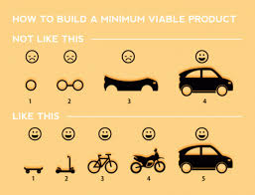
Demonstrating Value at Each Step
How to build a Minimally Viable Product
Not like this (incremental)…
Like this (iterative)...
Image credit: http://fastmonkeys.files.wordpress.com/2014/06/howtobuildmvp.gif?w=500

Slide 19
Activity:
Continue Developing the Story Map
Develop a Vision Statement
Continue brainstorming, incorporating feedback
Make the levels clear; Epics, Features, Stories
Identify MVP = Release 1 and subsequent two releases (Release 2 and 3)

Slide 20
What is A User Story?
Benefits:
User stories define the user experience
Emphasize verbal communication
Easily understood
The right size for planning - We only need enough detail in order to estimate the work
Details can be captured in Acceptance Test criteria
Better understanding of what you need
An invitation to a conversation about what is needed and can be done
A statement of functionality described in one or two sentences in the everyday language of the user

Slide 21
Components of a User Story
WHY
Motivation – the business benefit gained from the story
Role – the user role for the story
Goal – what the user is trying to accomplish
WHO
WHAT

Slide 22
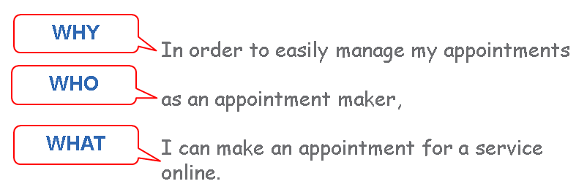
What is A User Story?
T
Benefits:
User stories define the user experience
Emphasize verbal communication
Easily understood
The right size for planning - We only need enough detail in order to estimate the work
Details can be captured in Acceptance Test criteria
Better understanding of what you need
An invitation to a conversation about what is needed and can be done
A statement of functionality described in one or two sentences in the everyday language of the user

Slide 23
Can a System Act as a User Role?
Other systems may be “user roles” IF they initiate the story
WHY
So I can report the error accurately and in a timely manner,
as iRepair I can populate the ticket based on performing diagnostics on the product or service that is assumed to be causing the problem.
WHO
WHAT

Slide 24
Example User Stories
To see my upcoming appointments, as an appointment maker I can view my appointments online. A MEANINGFUL GOAL
As an appointment maker I can view my appointments online. NO MEANINGFUL GOAL
As an appointment maker I can fill out my calendar. The information is written to the appointment database. NO END-TO-END FUNCTION

Slide 25
What Makes a Good User Story?
Independent
The story must have inherent value that is not dependent on the implementation of other stories
Can ideally select a story to work on without impacting other stories
Stories are not contracts; they are intended to facilitate understanding between the business and IT
Stories describe the “why” and the “what,” leaving the delivery team to negotiate and determine the “how”
Negotiable
Valuable
To users or customers, not developers
Rewrite developer stories to reflect value to users or customers
This is why we prefer vertical slices instead of horizontal slices
INVEST
Estimable
Because plans are based on user stories, we need to be able to estimate them
This enforces the discipline of well defined stories, avoiding the pitfall of vague stories
Small
Small enough to incorporate several into shorter development cycles enabling incremental delivery
Testable
We can define its acceptance criteria
Testable so that you have a defined, binary way of knowing when a story is finished
A User Story is either “Done” or “Not Done” (no partial credit)
Thanks to Bill Wake for the INVEST concept.

Slide 26
User Stories Need to Deliver User Value
ü
Ex: The user can enter data in a screen and the system will store it
User Interface
Business Logic
Horizontal Slice
Infrastructure
X
Vertical Slice
Ex: The database schema has been designed…

Slide 27
Activity:
Continue Developing the Story Map
Stop expanding the Story Map
Begin translating the verb-noun pairs from the MVP area to user stories (10)
Use the Why-Who-What format
Adhere to the INVEST criteria

Slide 28

Acceptance Criteria
Acceptance Criteria Are Tests - Acceptance tests for a user story provide the criteria to determine if the story has been correctly and fully implemented
Tests clarify the intent of the story
Test convey the user’s expectations
In this situation…, (context)
When I do …., (input)
I expect….. (expected results)
Tests should include the “happy path” and any significant exceptions that could occur
Tip: VTF should confirm the happy path scenario before the delivery team makes it robust (validate before verify)
Tests
PASS
Notes:
28
Acceptance tests are very important to user stories because the details of the stories emerge in the tests. The tests describe the expected behavior of the story – when a user does x, the expected result is y. Tests should include the user achieving their goal – the “happy path” – but should also include how the system should behave if the user encounters problems. There are usually multiple tests for one user story.

Slide 29
Examples of Acceptance Criteria
User Story: To Ensure that each appointment will be covered, as an appointment maker I can assign service providers to appointments.
Acceptance Criteria:
In the case when I have selected an unassigned appointment,
I expect that I can select a service provider to assign to it.
I expect that the service providers listed are available during the appointment duration.
In the case that I have assigned a service provider to the appointment,
I expect that the service provider’s calendar will be updated to reflect the assignment.
I expect that the service provider will be notified of the assigned appointment.

Slide 30
Examples of Acceptance Criteria for Non-Functional Requirements
User Story: To abide by legal requirements, as a new subscriber I have to accept Terms and Conditions.
Acceptance Criteria:
In the case when I have selected to create a new profile,
I expect that I can click “Accept” and be routed to establish login credentials.
I expect that if I do not select “Accept "that I will be unable to establish login credentials.
In the case when I have selected to log into an existing profile,
I expect that I will be routed to the appointments interface without being presented with Terms and Conditions.
I expect that I can click “Accept” and be routed to the appointments interface whenever Terms and Conditions dated later than those accepted by my profile are available in the system.

Slide 31
Questions to Ask to ensure the story gets to “Done”
Value Team Members write the Acceptance Criteria
Has the right members of the Value Team authored the Acceptance Criteria on those User Stories representing their “Who?”
Are Acceptance Testers members of the Value Team to provide well-written and complete acceptance criteria during User Story creation?
What else does the Delivery Team need to know about this story?
What am I assuming about this story will be implemented?
Are there circumstances when this story may behave differently?
What can go wrong during this story?

Slide 32
When there are too many stories
Story Prioritization
When there are too many stories for an iteration…
Sunny day scenarios / alternate paths / error handling
What stories are mandatory? (Without them, the value flow is broken?)
What stories are most valuable?
What stories are used most often?

Slide 33
When the stories are too large
Story Slicing
When stories are too big for an iteration…
A story can be an input screen or part of one – use a subset of data
Defer performance optimization – focus on functionality
Break up workflow steps
With or without data validation

Slide 34
Activity:
Acceptance Criteria
&
Grooming the Backlog
Complete Acceptance Criteria for your User Stories
VTF collaborates to establish priorities of the stories in the MVP
Delivery Team members help identify dependencies and negotiate changes to priorities.
Slice big stories

Slide 35
Agile Estimating – Why?
Desired Outcomes
So that…
The team is aligned on what each user story means and our approach to implementing it
The team is aligned on the relative effort to implement each
To be ready for iteration planning
Estimate enough of the product backlog to fill the first iteration in order to start the first iteration as soon as possible

Slide 36
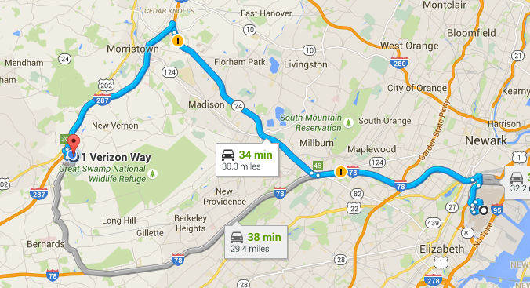

Fundamentals for Estimating User Stories
Estimate Effort (Not Time)
How far is it from your home to the nearest airport?
How long does it take to get there?
Use Relative Estimating (Not Absolute)
Make A:B comparisons and ask: “Which is larger?”
Don’t ask “How big is this?”
From Verizon in Basking Ridge to EWR
Distance: 31 miles +/- 1 mi
Travel time: Between 30 and 90 minutes
Determine the attribute we are comparing: Weight? Volume? How long it takes to prepare? (What is the effort to code and test the user story for the demo?)

Slide 37



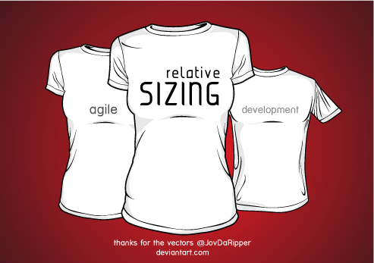
Relative Estimation
Estimating the size of a story (e.g., epic, theme, user story) based on the size of another one to judge whether it is smaller, the same or larger than the other.
Notes:
Which is bigger and which takes more effort to eat?
158403411
iStock
Item number:488478289
492797367
iStock
Vector T-shirt Templateby JovDaRipper
Resources & Stock Images / Vector Resources©2009-2014 JovDaRipper
Made a new an better T-shirt template! Now for both male and female, back and front! Vector T-shirt Templateby JovDaRipper In Adobe Illustrator you can customize placements and colors if you want, but I would appreciate it if you left my name somewhere for credit Otherwise I don't got any strict rules for this, just use it and have fun!

Slide 38
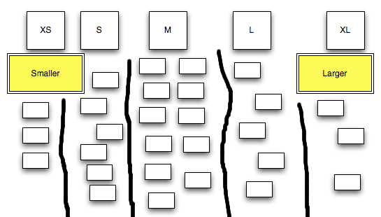
Affinity Estimation
- A technique designed to rapidly estimate a large product backlog.
It uses shirt sizes to place user stories into similarly sized groups.
http://www.gettingagile.com/wp-content/uploads/2008/07/relativesizeditems-inbuckets.png
Why: Develop a ROM (rough order of magnitude) guess at the beginning – how big is this?
When: When we have a story map with verb-noun pairs (short form of user stories)
How: One or two SMEs quickly read each verb-noun pair and assign a t-shirt size (XL, Large, and Medium stories have much great impact on overall size than Small, XS)

Slide 39
When to Estimate - At What Time? - On What Scale?
Keeping in mind the concept of Progressive Elaboration, estimation occurs several times during the lifecycle of an Agile project and uses different scales at different times.
More accurate predictions can be made the closer the estimation is to beginning the work.
Artifact | When | Level of Detail | Technique | Scale
Product Backlog | Release Planning | High Level Details Available | Affinity Estimation | XS, S, M, L, XL, XXL
Iteration Backlog | Iteration Planning | Low Level Details Available | Relative Estimation Story Points | 1, 2, 3, 5, 8, 13, 20
Technical Task | Iteration Planning | Low Level Details Available | Hours | 1, 2, 4, 6
Notes:
Kelly

Slide 40
Planning Pyramid – Verizon’s Tool for Story Point Estimation (MVP version)
NEW!
Link for the moderator - not participants:
http://v19frdgda08.ebiz.verizon.com:8080/AgilePlanner/
To estimate story points for user stories, our colleagues in India have built a web-based tool that we can host internally to allow teams to do agile estimating.
Benefits:
Geographically distributed agile teams
Option to Revote
Any number of participants
Reference estimates
Multiple sessions
Ability to save results to PDF
Current Constraints:
Not integrated with other tools
No reports
No saving capability once session is closed
Development Credit:
Kamal Jain
Lakshmi U
Gladius Thayalarajan
Willam C Robert
Thejdeep Thupili
Padma Rangarajan
Thank you!!
For update suggestions, please email:
Padma.Rangarajan@one.verizon.com

Slide 41

Story Point Estimating – Quick Reference Guide
The technique we will use is called “planning poker”
The delivery team reviews all user stories and selects a reference story, a small story and assigns a score of 2 story point.
The VTF/Moderator reads a story (one at a time).
The delivery team asks the VTF to clarify the user story, if needed
The VTF/Moderator asks each delivery team member to vote what they think the story point should be (i.e., relative effort) compared to the reference story.
Each deliver team member provides their vote.
The delivery team views all scores. If the scores are different, the team members provide their reasons for the outlying votes. They vote again to come to a consensus. Assumptions are recorded in the product backlog.
The VTF listens for surprisingly large or small estimates that suggest mis-alignment on intent.

Slide 42

Activity: Moving Your Apartment
Using Relative Estimation and Planning Poker, estimate the effort to move your stuff
Relative Comparisons:
Kitchen chair = 2 points
60” flat screen TV = 8 points
Planning Poker: 1, 2, 3, 5, 8,13, 20
Image credit: http://renters.apartments.com/biggest-moving-day-of-the-year
Kitchen table
4 kitchen chairs
Sofa
2 comfortable chairs
2 End tables
4 Lamps
Queen-size bed
20 medium-size boxes
10 boxes of books
4 boxes of kitchen stuff
3 closets full of clothing
2 dressers
Notes:
Talking points:
In agile estimating, we always want to use relative estimating (comparing A to B) and not absolute estimating (looking at one thing and estimating)
In Planning Poker estimating, we only use the numbers in the set: 1, 2, 3, 5, 8, 13, 20
Discussion points:
There are some tricks in this example – do you see them? (size can be interpreted as height, weight, or length; some breeds are ambiguous)
Why are there missing numbers in the planning poker set? Why is the distance between number larger at the high end of the set?

